Slide 1
UIowa AIAA MAV Team
Project Lead: Austin Brenner

Slide 2
Team Roster
Advisor: Kevin Trojanowski
Members: Vicki, Ryan, Alec, Andrew, Matt, and Frank

Slide 3
Rocket Design
Material: Fiberglass
Weight, cost, manufacturability
Static stability Margin:2.17cal*

Slide 4
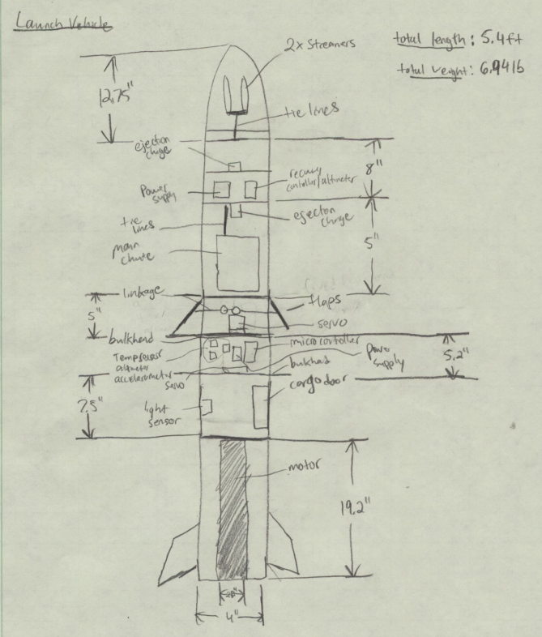

Slide 5
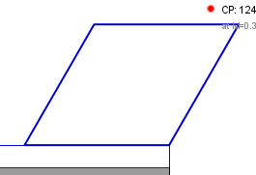
Structure Systems
Nosecone: Ogive 4 Polypropylene
Fins: 4x Carbon Fiber 1/16” plate
h=5”
root=6”
tip=6”
angle=30°

Slide 6
AGSE Design will capture, contain, and launch the payload
Material: aluminium, steel, rubber, acrylic.
Servo conveyor systems
Linear Actuators
Servo Winch
Proximity switches
Torsion Springs

Slide 7
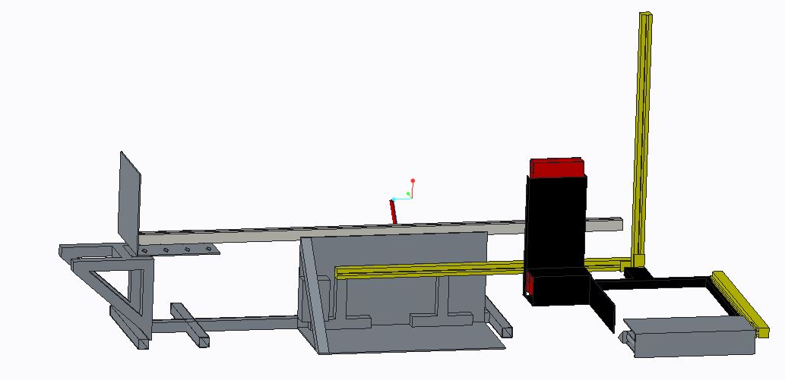
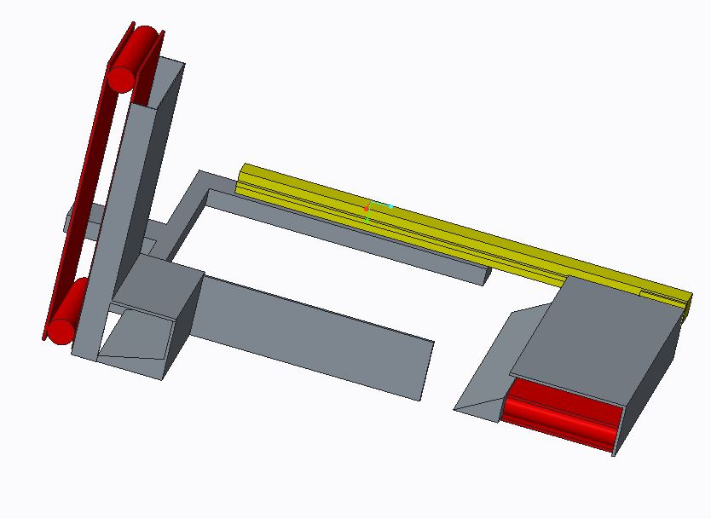

Slide 8
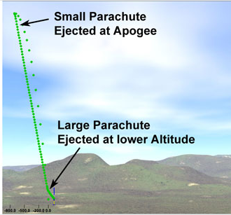
Recovery System
Parachute selection
Dual deployment system
Testing

Slide 9
Drag System
Geometry selection
Control Programming

Slide 10
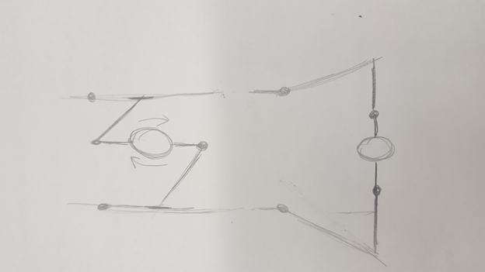

Slide 11
Control System
Sensor selection
Accelerometer, Altitude/Pressure, Temperature, IR Receiver
Safety kill switch for failure to launch
Controller software design
System interaction

Slide 12
Control System Options

Slide 13
Cargo Bay System
Rotating inner cylinder
Secure Payload
Controls
Servo motor
Light dependent resistor

Slide 15
Motor Selection
K261-P Motor
Weight increase
Drag system to bring down altitude
Simulated using OpenRocket software

Slide 16
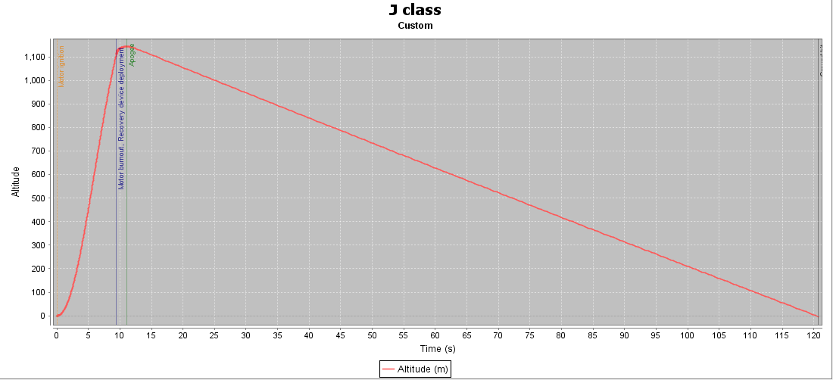
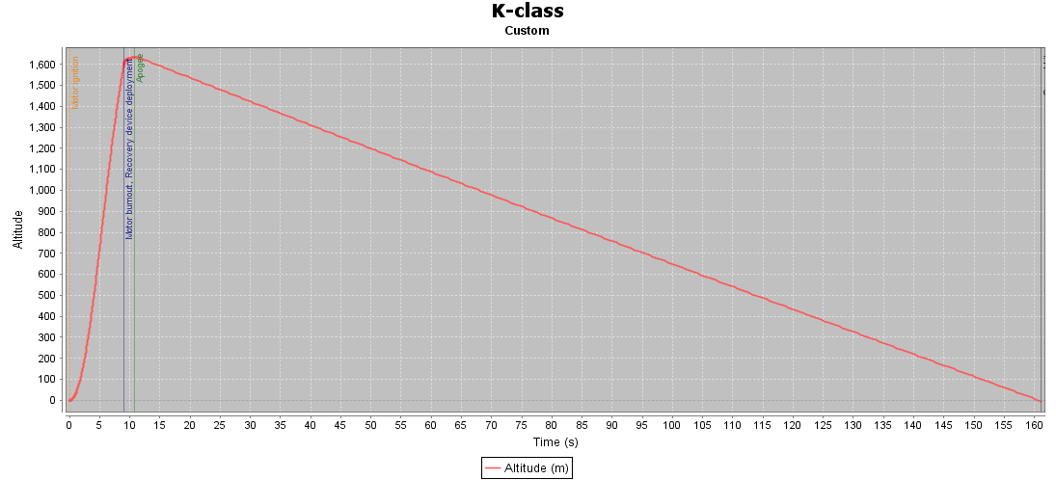
Exit Rail Velocity - 13.4 m/s
Apogee - 1144 m ~ 3753 ft
Exit Rail Velocity - 16.7 m/s
Apogee - 1632 m ~ 5354 ft

Slide 17
Propulsion Parameters
Thrust to Weight: ~9.108
Rail Exit Velocity: 16.7 m/s
Max Velocity: 249 m/s
Max Acceleration: 66.1 m/s²

Slide 18
Safety/ Risk

Slide 19
Verification and Testing
Drag/Payload bay motor test
Drag system CFD analysis
Ground recovery system test of linear actuators and servo conveyors for AGSE.

Slide 20
Questions?

Slide 21
Sources
https://www.apogeerockets.com/Intro_to_Dual_Deployment_in_Rocketry

